Slide 1
EBC-RC04 JetPack OTA
2026/3/2 Dennis

Slide 2
Outline
What is NVIDIA OTA
OTA Flow
Backup Mechanism
Customer Scenario on EBC-RC04

Slide 3
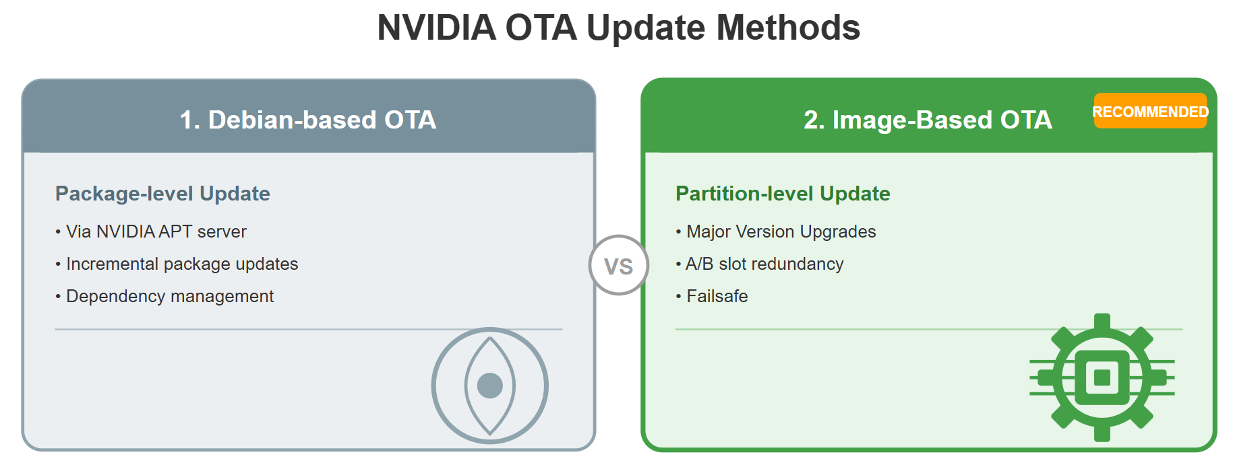
What is NVIDIA OTA

Slide 4
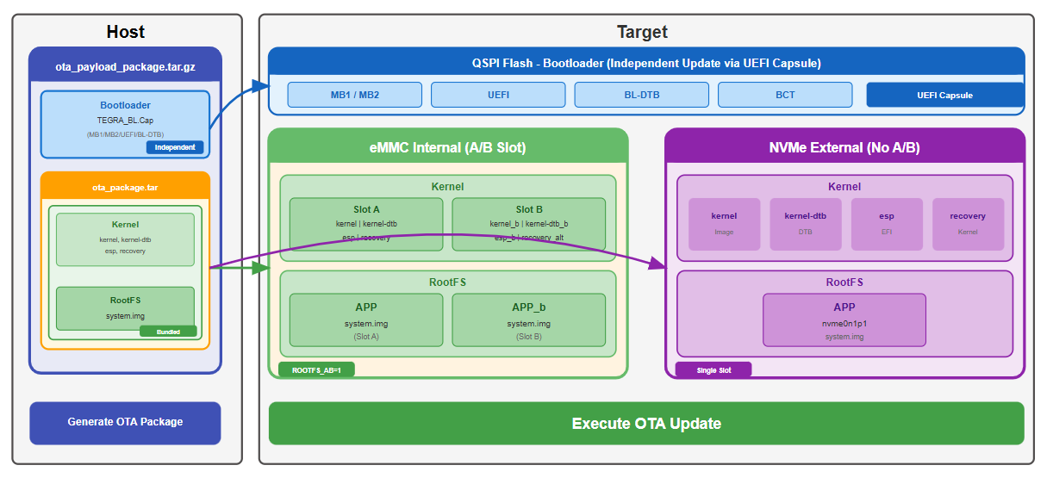
What is Image-Based OTA

Slide 5
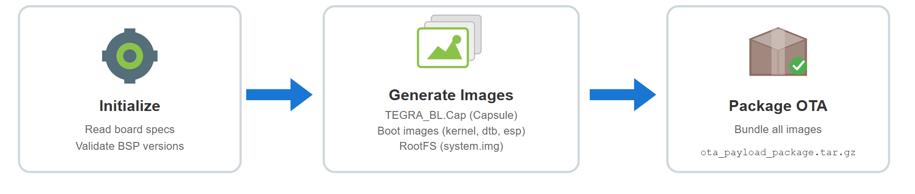
Generate OTA Package
Constructing the OTA payload on Host : l4t_generate_ota_package.sh

Slide 6
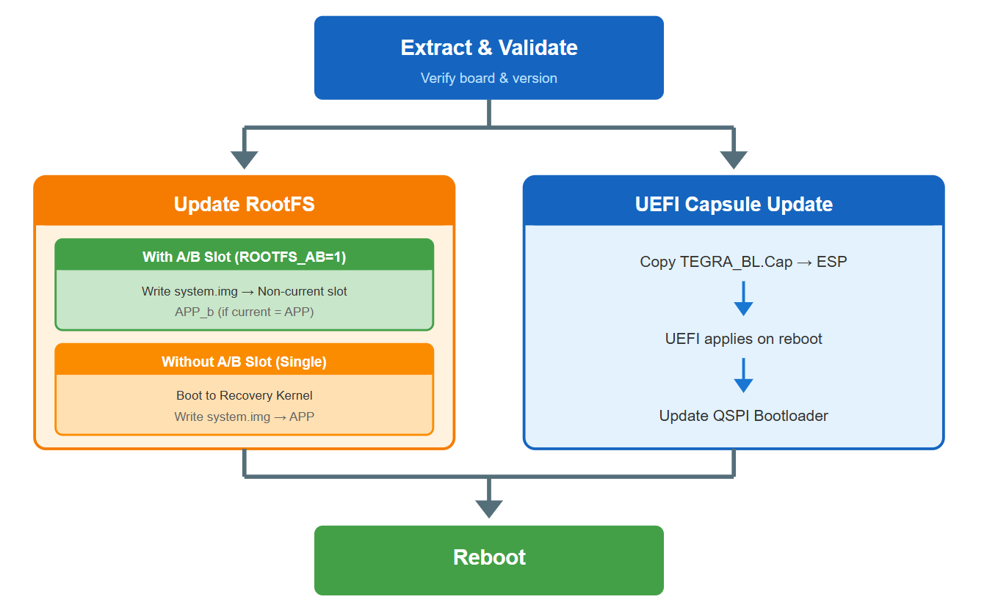
Execute OTA Update
Safely apply the update via nv_ota_start.sh

Slide 7
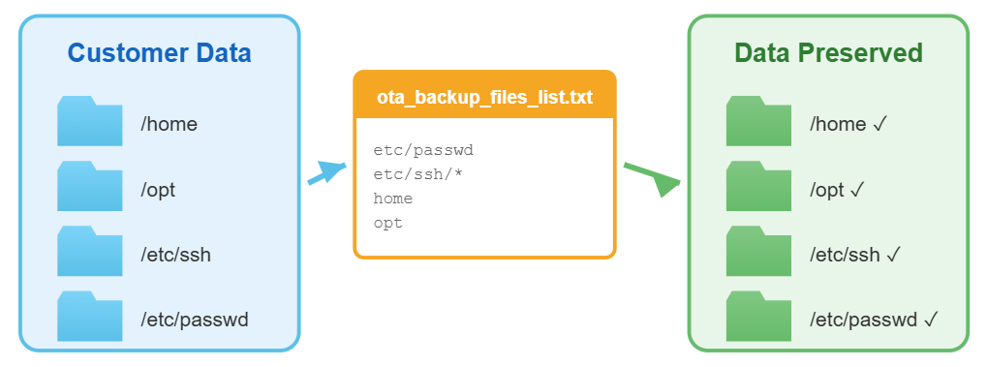
Backup Mechanism
The ota_backup_files_list.txt file should be configured to preserve customer data during the OTA update process.

Slide 8
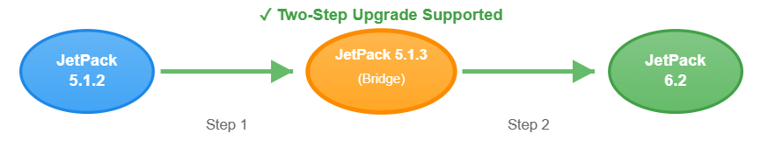
Customer Scenario on EBC-RC04
Direct OTA upgrade from Jetpack 5.1.2 to 6.2 is NOT supported.
We use Jetpack 5.1.3 (Standard BSP) as an intermediate bridge.

Slide 9
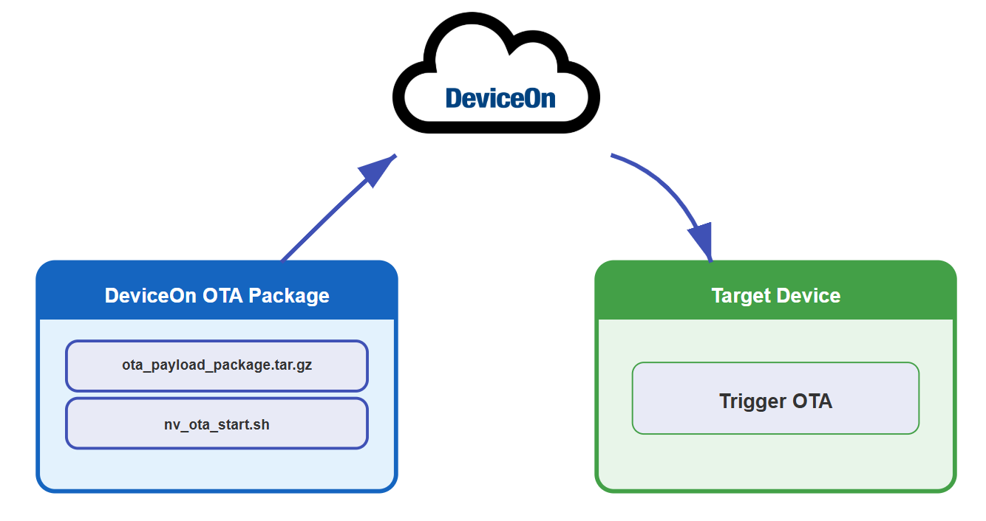
Integrate DeviceOn OTA

Slide 10
Document reference
https://ess-kms.edgecenter.io/en/wiseec/public/Nvidia/EBC_RC04_OTA
https://ess-kms.edgecenter.io/en/wiseec/internal/Nvidia/OTA_Package_Flow

Slide 11
Go Together,
We Go Far and Grow Big

